Slide 1
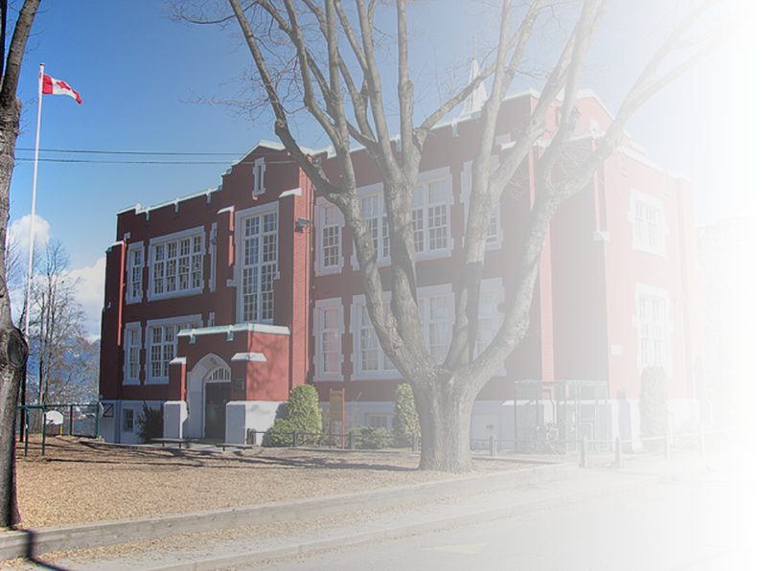
Queen Mary Elementary
PAC Meeting
Tuesday May 6, 2025
7:30-9:00pm

Slide 2
With deep gratitude and respect, we are honoured to be learning and unlearning on the ancestral and unceded lands of the xʷməθkʷəy̓əm (Musqueam), Sḵwxwú7mesh Úxwumixw (Squamish Nation) & səlilwətaɬ (Tsleil-Waututh Nation)

Slide 3
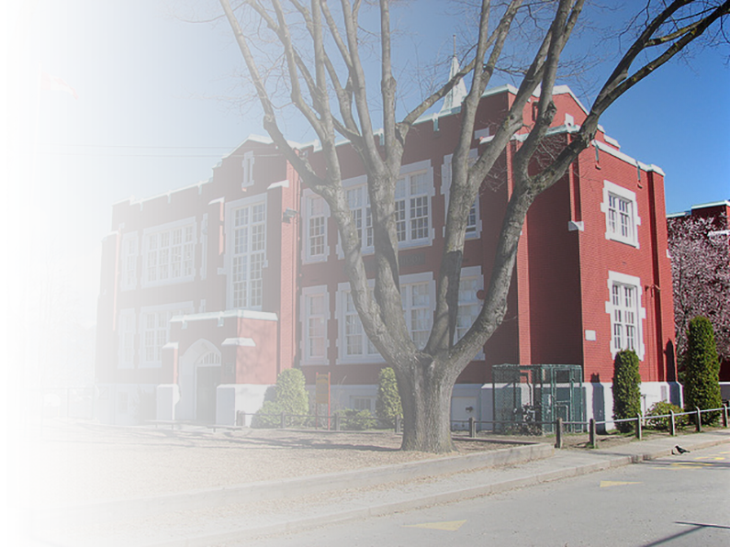
Agenda
Welcome
Principal’s Report
Treasurer Report
PAC Report
  Recent PAC Events
  Alumni scholarship applications (May 9)
  June Celebration (June 6)
  Teacher Appreciation Luncheon (June 17)
  Direct Drive
  Open roles on PAC Exec
  Next Parent Coffee Morning (May 27)
  QM PAC AGM (June 3)
Wrap-up

Slide 4
Voting
Queen Mary PAC uses a general parliamentary procedure which includes:
Presenting a motion
Seconding a motion
If no one is opposed to the motion, the motion carries - unanimous consent
Otherwise, we vote on the motion. Motion carries with majority support

Slide 5
Agenda Approval
”I move to approve the agenda”
Welcome
Principal’s Report
Treasurer Report
PAC Report
  Recent PAC Events
  Alumni scholarship applications (May 9)
  June Celebration (June 6)
  Teacher Appreciation Luncheon (June 17)
  Direct Drive
  Open roles on PAC Exec
  Next Parent Coffee Morning (May 27)
  QM PAC AGM (June 3)
Wrap-up
“I second”
“Is there anyone opposed”?

Slide 6
Minutes Approval – March and April 2025
https://www.queenmarypac.com/about/meeting-minutes-2024-2025
”I move to approve the minutes”
“I second”
“Is there anyone opposed”?

Slide 7
Agenda
Welcome
Principal’s Report
Treasurer Report
PAC Report
  Recent PAC Events
  Alumni scholarship applications (May 9)
  June Celebration (June 6)
  Teacher Appreciation Luncheon (June 17)
  Direct Drive
  Open roles on PAC Exec
  Next Parent Coffee Morning (May 27)
  QM PAC AGM (June 3)
Wrap-up

Slide 8
Principal’s Report (Elyssa)

Slide 9
Agenda
Welcome
Principal’s Report
Treasurer Report
PAC Report
  Recent PAC Events
  Alumni scholarship applications (May 9)
  June Celebration (June 6)
  Teacher Appreciation Luncheon (June 17)
  Direct Drive
  Open roles on PAC Exec
  Next Parent Coffee Morning (May 27)
  QM PAC AGM (June 3)
Wrap-up

Slide 10
Treasurers’ Report (Raymond)
Balance at end of March: $17,430

Slide 11
Agenda
Welcome
Principal’s Report
Treasurer Report
PAC Report
  Recent PAC Events
  Alumni scholarship applications (May 9)
  June Celebration (June 6)
  Teacher Appreciation Luncheon (June 17)
  Direct Drive
  Open roles on PAC Exec
  Next Parent Coffee Morning (May 27)
  QM PAC AGM (June 3)
Wrap-up

Slide 12
PAC Report
  Recent PAC Events
  Alumni scholarship applications (May 9)
  June Celebration (June 6)
  Teacher Appreciation Luncheon (June 17)
  Direct Drive
  Open roles on PAC Exec
  Next Parent Coffee Morning (May 27)
  QM PAC AGM (June 3)

Slide 13
Recent PAC Events / Shout-Outs
Earth Day / Garden Day (Thanks Erin!)
Author Visits (Thanks Melissa)
  May 12 (Jeff Chiba Stearn) for the intermediate classes
  May 16 (Lee Edward Fodi) for the primary classes
Behind the scenes
  Thanks Pauline for acting as our community programs coordinator
  Thanks Camelia for acting as our communications officer!
  Thanks Raymond for keeping our accounts in order!
  Thanks Natalia for the notes and meeting minutes
Thanks Heidi for the crossing guards and June celebration!
Thanks Laura for handling the direct drive and the teacher appreciation luncheon!
Thanks Chris and Laura for organizing the grade 7 leaving celebration!

Slide 14
PAC Report
  Recent PAC Events
  Alumni scholarship applications (May 9)
  June Celebration (June 6)
  Teacher Appreciation Luncheon (June 17)
  Direct Drive
  Open roles on PAC Exec
  Next Parent Coffee Morning (May 27)
  QM PAC AGM (June 3)

Slide 15
Alumni Scholarship Applications
https://www.queenmarypac.com/scholarship
$1,000 Cash Award for QM alumnus upon acceptance into a full-time post secondary education program
Application deadline is May 9, 2025

Slide 16
PAC Report
  Recent PAC Events
  Alumni scholarship applications (May 9)
  June Celebration (June 6)
  Teacher Appreciation Luncheon (June 17)
  Direct Drive
  Open roles on PAC Exec
  Next Parent Coffee Morning (May 27)
  QM PAC AGM (June 3)

Slide 17
June Celebration
”I move to approve $1500 from the general account to cover the costs of putting on the June Celebration
“I second”
Friday, June 6, after school (approximately 4:00 - 8:00 or 3:00 - 7:00)
Event includes:
Games
Entertainment - a QM talent show!
Food
Dancing
Silent Auction
Lots of fun!
Admission will be free to make it accessible to all. Will sell pizza and games tickets to cover costs of food and prizes. Potential fundraising through silent auction. The expectation is to nearly break even on the event, but asking the PAC to approve $1500 to cover the up-front costs of putting on the event.
Budget assuming 400 people, based on data from previous similar events
$800 for snacks, drinks, pizza, and related supplies (napkins, etc.)
$700 for prizes and craft supplies
We need volunteers to help with organization now, and volunteers on the day.
Please email inquiries to queenmarypac1@gmail.com or heidi.k.nienaber@gmail.com
“Is there anyone opposed”?

Slide 18
PAC Report
  Recent PAC Events
  Alumni scholarship applications (May 9)
  June Celebration (June 6)
  Teacher Appreciation Luncheon (June 17)
  Direct Drive
  Open roles on PAC Exec
  Next Parent Coffee Morning (May 27)
  QM PAC AGM (June 3)

Slide 19

Teacher Appreciation Luncheon
Taco Party on June 17
Flyers distributed to classes
Some donations coming in. Need to reach $1300 to cover the catering costs.
Total estimated costs $2800

Slide 20
PAC Report
  Recent PAC Events
  Alumni scholarship applications (May 9)
  June Celebration (June 6)
  Teacher Appreciation Luncheon (June 17)
  Direct Drive
  Open roles on PAC Exec
  Next Parent Coffee Morning (May 27)
  QM PAC AGM (June 3)

Slide 21
Direct Drive
Website link is active. Will prepare and share a flyer to send home with students.
Requested items:
Rig-A-Ma Jig set.(approx. $7,000 CAD)
Queen Mary outdoor banner/flag + stand. (approx $500)
Home reading books for more advanced readers (approx. $1,500)
New carts with specialized art suppplies. These carts will be shared between divisions. (approx. $2,000)
Indoor Ringette set. (approx $1,000)
Book bags for primary students. (approx $500)
2 collapsable canopies to use for sporting events or emergencies. (approx. $1,000)
Library fund to update and or replace library books. ($1,500)
Technology replacement fund. This fund would allow Queen Mary to replace damaged equipment such as iPads or computers as the need arises. ($10,000)

Slide 22
PAC Report
  Recent PAC Events
  Alumni scholarship applications (May 9)
  June Celebration (June 6)
  Teacher Appreciation Luncheon (June 17)
  Direct Drive
  Open roles on PAC Exec
  Next Parent Coffee Morning (May 27)
  QM PAC AGM (June 3)

Slide 23
Open Roles on PAC Exec
The QM PAC constitution describes the roles of the PAC Exec
For 2025, the PAC needs volunteers for the following open roles
  Chair: chair meetings, uphold constitution, communications with PAC
  Vice-Chair: assume responsibilities of chair in the chair’s absence
  Secretary: distribute minutes
  Treasurer: maintain accounts and disperse funds
Email queenmarypac1@gmail.com for more information or to discuss the roles and responsibilities

Slide 24
PAC Report
  Recent PAC Events
  Alumni scholarship applications (May 9)
  June Celebration (June 6)
  Teacher Appreciation Luncheon (June 17)
  Direct Drive
  Open roles on PAC Exec
  Next Parent Coffee Morning (May 27)
  QM PAC AGM (June 3)

Slide 25
Parent Coffee Morning
Cory and Ann have graciously volunteered to host the next parent-coffee morning on May 27 at 9am.
Coffee generously donated by Max at Bean Around the World
Good chance to discuss the PAC Exec roles with potential new members
Please try to attend the coffee morning, and share with your networks

Slide 26
PAC Report
  Recent PAC Events
  Alumni scholarship applications (May 9)
  June Celebration (June 6)
  Teacher Appreciation Luncheon (June 17)
  Direct Drive
  Open roles on PAC Exec
  Next Parent Coffee Morning (May 27)
  QM PAC AGM (June 3)

Slide 27
Annual General Meeting
The AGM is June 3
Voting for new PAC Exec
Final plans or approvals for Summer Celebration
Current PAC Chair is unable to host due to travel – need a volunteer to host this meeting

Slide 28
Agenda
Welcome
Principal’s Report
Treasurer Report
PAC Report
  Recent PAC Events
  Alumni scholarship applications (May 9)
  June Celebration (June 6)
  Teacher Appreciation Luncheon (June 17)
  Direct Drive
  Open roles on PAC Exec
  Next Parent Coffee Morning (May 27)
  QM PAC AGM (June 3)
Wrap-up

Slide 29
Queen Mary’s Code of Conduct
We respond everyone’s learning by respecting ourselves, others and our surroundings
Queen Mary’s Mission Statement
Our mission is to build a respectful community of lifelong learners
We work toward becoming caring, accomplished and cooperative citizens
We aim to provide an enriched environment in which children are encouraged to think, question, create and wonder
Next meeting
Is the Annual General Meeting (AGM)
Tuesday June 3
7:30 to 8:30pm

